Slide 1

8086 Assembly
Problem Set 1

Slide 2

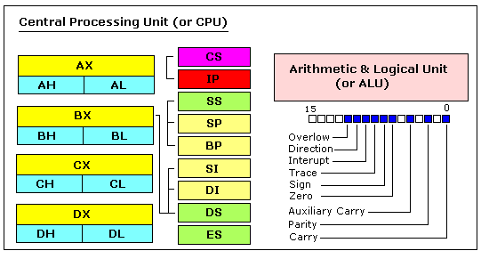



8086 Registers

Slide 3

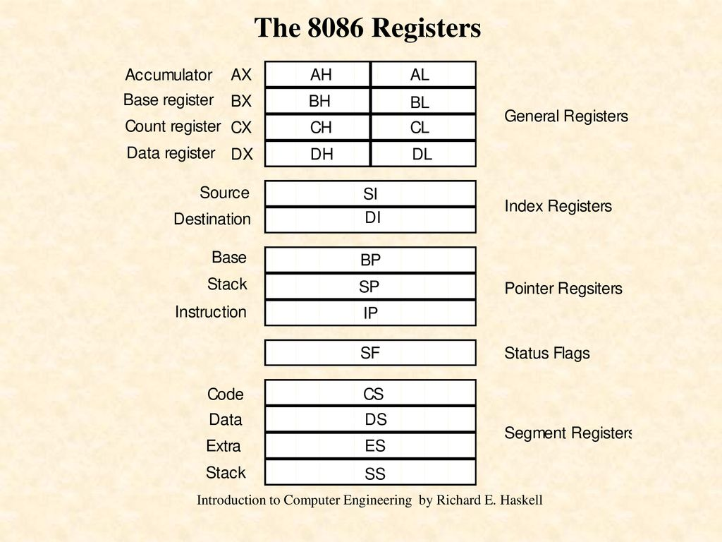
8086 Registers

Slide 4
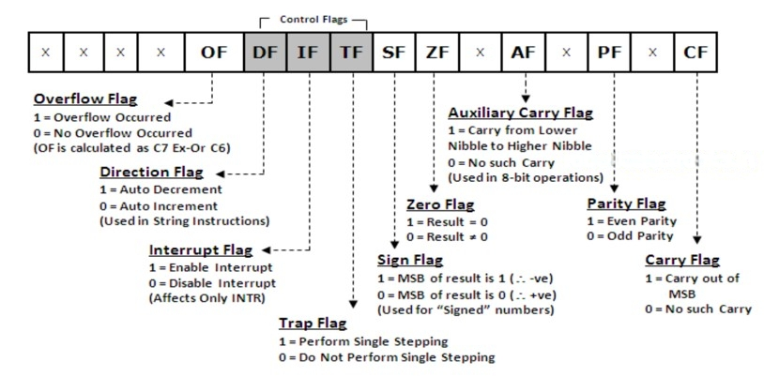
8086 Flags

Slide 5
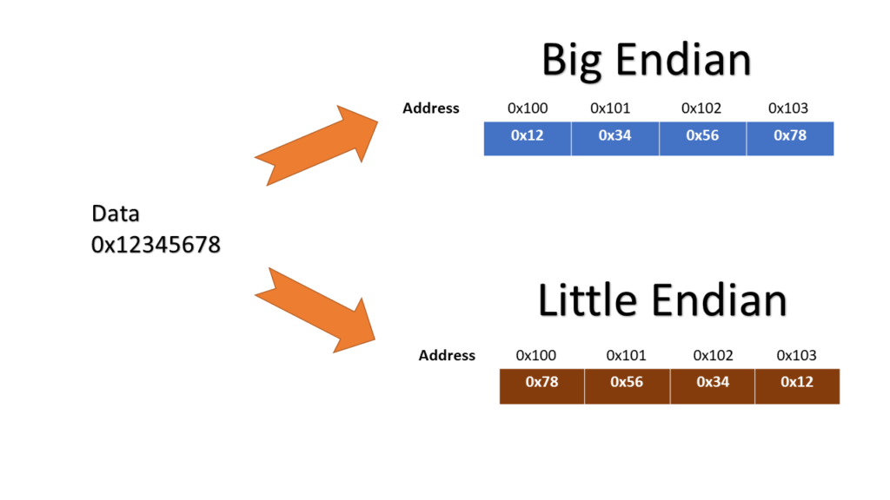
Little Endian vs Big Endian
Humans are Big Endian
In a little-endian system, the address of a given value in memory, taken as a 32-, 16-, or 8-bit width, is the same making CASTING (and Arithmetic Ops) easier.

Slide 6

Physical vs Logical Address
8086 has a 16-bit Registers BUT 20-bit address bus, Why? To get 1M Memory (2 ^ 20)
Solution:
1. Shift segment address 4-bits to the left (SHIFT BASE)
2. Add Index address to the shifted base address (ADD OFFSET)
Example CS = 348AH, IP = 4214H then the next instruction is at
348A0H + 4214H = 38AB4H
Logical Address → segment:offset
Physical Address → absolute number
Memory in 8086 is Byte Addressable

Slide 7
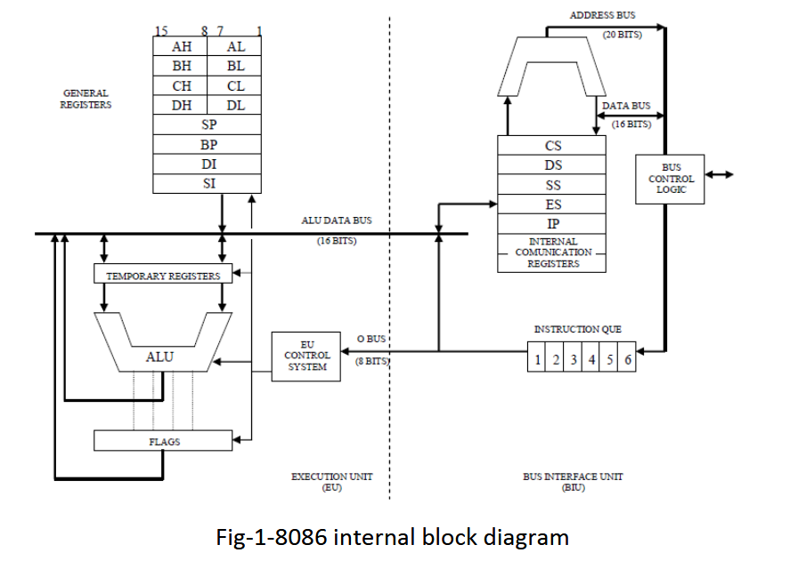
Side Note: 8086 has another ALU-ish
The feature of fetching the next instruction while the current instruction is executing is called pipelining

Slide 8
Addressing Modes
Addressing Mode | Example | Notes
Immediate | Mov AL, 20
Register | Mov AL, BL
Direct | Mov AL, [0200] | [0200] = Content of DS:0200
Register Indirect | Mov AL, [BX] | [BX] = Content of the address in DS:BX
Based Relative | Mov AL, [BX+2] | [BX] = Content of the address in DS:(BX + 2)
Indexed Relative | Mov AL, [SI+2] | [SI] = Content of the address in SS:(SI + 2)
Based Indexed | Mov AL, [BX][SI]+2 | [BX][SI]+2 = Content of the address in DS:(BX+SI+2)
The 8086 provides powerful instruction set with the addressing modes:

Slide 9
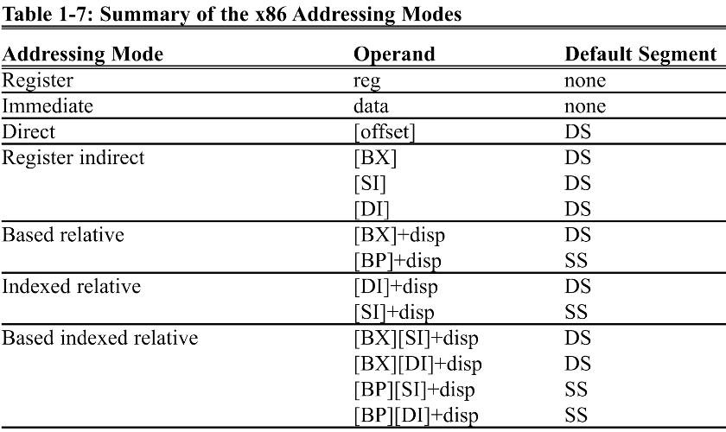
Addressing Modes

Slide 10
Problem 1
State another way to increase the processing power of the CPU other than increasing the frequency.
Pipelining
Increasing Number of Cores

Slide 11
Problem 2
Which of the following instructions cannot be coded in 8086 Assembly language? Give the reason why not, if any.
Yes
No, Operands Size doesn’t match
No, Invalid Operation (using immediate value with a segment register)
Yes
a) MOV AX,27
b) MOV AL,97F
c) MOV DS,9BF2
d) MOV CX,397

Slide 12
Problem 2
Which of the following instructions cannot be coded in 8086 Assembly language? Give the reason why not, if any.
Yes, 9516 is moved to DS:0081 (TESTED OK)
No, No, Invalid Operation (using immediate value with a segment register)
Yes
Yes
e) MOV 81,9516
f) MOV CS,3490
g) MOV DS,BX
h) MOV BX,CS

Slide 13
Problem 2
Which of the following instructions cannot be coded in 8086 Assembly language? Give the reason why not, if any.
No, operands do not match: 8 bit and 16-bit register
No, no 'h' suffix; or unmatched operands
No, operands do not match: 8 bit and 16-bit register
No, operands do not match: 16-bit and 8-bit register
i) MOV CH,AX
j) MOV AX,23FB9
k) MOV CS,BH
l) MOV AX,DL

Slide 14
Problem 3
If an instruction that needs to be fetched is in physical memory location 389F2 and CS = 2700, does the code segment range include it or not?
CS range is
CS Lower = 27000 + 0000 = 27000
CS Higher = 27000 + FFFF = 36FFF
Then 389F2 is not in the range

Slide 15
Problem 3
If an instruction that needs to be fetched is in physical memory location 389F2 and CS = 2700, does the code segment range include it or not? If not, what value should be assigned to CS if the IP must be = 1282?
CS x 10 + 1282 = 389F2
CS x 10 = 389F2 – 1282 = 37770
Then CS = 3777

Slide 16
Problem 4
Assume that SP = FF2EH, AX = 3291H, BX = F43CH, and CX = 09. Find the content of the stack and stack pointer after the execution of each of the following instructions.
PUSH AX
PUSH BX
POP AX
PUSH CX
POP BX

Slide 17
8086 Stack
8 - bits
Stack is Byte - Addressable
STACK
FFFF
PUSH a Register (Word)
SP = SP - 2
POP a Register (Word)
SP = SP + 2
00010101
Single Word
00000000
0000

Slide 18
Problem 4
STACK GROWS DOWNWARD
Assume that SP = FF2EH, AX = 3291H, BX = F43CH, and CX = 09. Find the content of the stack and stack pointer after the execution of each of the following instructions.
PUSH AX
PUSH BX
POP AX
PUSH CX
POP BX
 | Stack [Empty] | SP [FF2EH]
PUSH AX | FF2D → 32 FF2C → 91 | FF2C
PUSH BX | FF2D → 32 FF2C → 91 FF2B → F4 FF2A → 3C | FF2A
POP AX | FF2D → 32 FF2C → 91 | FF2C
PUSH CX | FF2D → 32 FF2C → 91 FF2B → 00 FF2A → 09 | FF2A
POP BX | FF2D → 32 FF2C → 91 | FF2C

Slide 19
Problem 5
What is the function of the following code?
PUSH AX
PUSH BX
POP AX
POP BX
Swap AX, BX → XCHG AX, BX

Slide 20
Problem 6
What is the main disadvantage of using the stack as temporary storage compared to having a large number of registers inside the CPU?
The main disadvantage is that it’s in memory, and memory is slower than CPU registers in a variety of ways. It usually has longer latency and lower bandwidth. Memory accesses are harder to speed up.

Slide 21
Problem 7 - a
Find the status of the CF, PF, AF, ZF, and SF for the following operations.
MOV BL,9FH
ADD BL,61H
 | CF | PF | AF | ZF | SF | OF
MOV BL, 9FH | 0 | 0 | 0 | 0 | 0 | 0
ADD BL, 61H | 1 | 1 | 1 | 1 | 0 | 0
Steps Required
Note: OF flag works in case of Signed operations only
(when carry is from 7th bit to 8th bit or 15th to 16th)

Slide 22
Problem 7 - b
Find the status of the CF, PF, AF, ZF, and SF for the following operations.
MOV AL,23H
ADD AL,97H
 | CF | PF | AF | ZF | SF | OF
MOV AL, 23H | 0 | 0 | 0 | 0 | 0 | 0
ADD AL, 97H | 0 | 0 | 0 | 0 | 1 | 0

Slide 23
Problem 7 - c
Find the status of the CF, PF, AF, ZF, and SF for the following operations.
MOV DX,10FFH
ADD DX,1
 | CF | PF | AF | ZF | SF | OF
MOV DX, 10FFH | 0 | 0 | 0 | 0 | 0 | 0
ADD DX, 1 | 0 | 1 | 1 | 0 | 0 | 0

Slide 24
Problem 8
Assume that the registers have the following values (all in hex)
Calculate the physical address of the memory where the operand is stored and the contents of the memory locations in each of the following addressing examples.
CS = 1000 | AX = 25FF | SI = 4000
DS = 2000 | BX = 6080 | DI = 5000
SS = 3000 | CX = 8791
ES = 9000 | DX = 1299

Slide 25
Problem 8
Note: The Question covers two points
Which segment to use as base address?
What value to use? How many bytes?

Slide 26
Problem 8
CS = 1000 | AX = 25FF | SI = 4000
DS = 2000 | BX = 6080 | DI = 5000
SS = 3000 | CX = 8791 | BP = 7000
ES = 9000 | DX = 1299
MOV [SI], AL
Reference by DS
DS:SI
Physical memory location = 20000 + 4000 = 24000
24000 → FF

Slide 27
Problem 8
CS = 1000 | AX = 25FF | SI = 4000
DS = 2000 | BX = 6080 | DI = 5000
SS = 3000 | CX = 8791 | BP = 7000
ES = 9000 | DX = 1299
MOV [SI+BX+8], AH
Reference by DS
Physical memory location = 20000 + 4000 + 6080 + 8 = 2A088
2A088 → 25
MOV [BX], AX
Reference by DS
Physical memory location = 20000 + 6080 = 26080
26080 → FF
26081 → 25

Slide 28
Problem 8
CS = 1000 | AX = 25FF | SI = 4000
DS = 2000 | BX = 6080 | DI = 5000
SS = 3000 | CX = 8791 | BP = 7000
ES = 9000 | DX = 1299
MOV [DI+6], BX
Reference by DS
Physical memory location = 20000 + 5000 + 6 = 25006
25006 → 80
25007 → 60
MOV [BX][DI]+28, CX
Reference by DS
Physical memory location = 20000 + 6080 + 5000 + 28 = 2B0A8
2B0A8 → 91
2B0A9 → 87

Slide 29
Problem 8
CS = 1000 | AX = 25FF | SI = 4000
DS = 2000 | BX = 6080 | DI = 5000
SS = 3000 | CX = 8791 | BP = 7000
ES = 9000 | DX = 1299
MOV [BP][SI]+10, DX
Reference by SS
Physical memory location = 30000 + 7000 + 4000 + 10 = 3B010
3B010 → 99
3B011 → 12

